Slide 1
Working in a great team… (1)
Eight characteristics of successful teams
„Change to grow" Training Consulting Coaching
September 2017– Wolfgang Schmitt

Slide 2
8 characteristics of successful teams!
Criteria that make teamwork not only successful but a great pleasure as well…

Slide 3
A three – year study* of 60 extraordinary teams identified 8 characteristics that all of these teams had in common..
These 8 characteristics seemed to be the indicators for a high performance team..
*Study by „management is a journey corp.“ / 2015

Slide 4
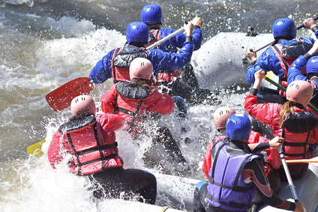
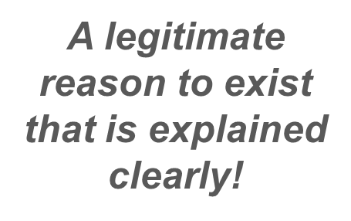
1 They have a compelling purpose.

Slide 5
2 They have shared leadership
The team is not build around one person!

Slide 6
3 They have just enough structure
They find the right balance between structure and flexibility!

Slide 7
4 They have full engagement
All teammembers are active and committed!

