Slide 1
Working in a great team… (2)
Eight characteristics of successful teams
„Change to grow" Training Consulting Coaching
September 2017 – Wolfgang Schmitt

Slide 2
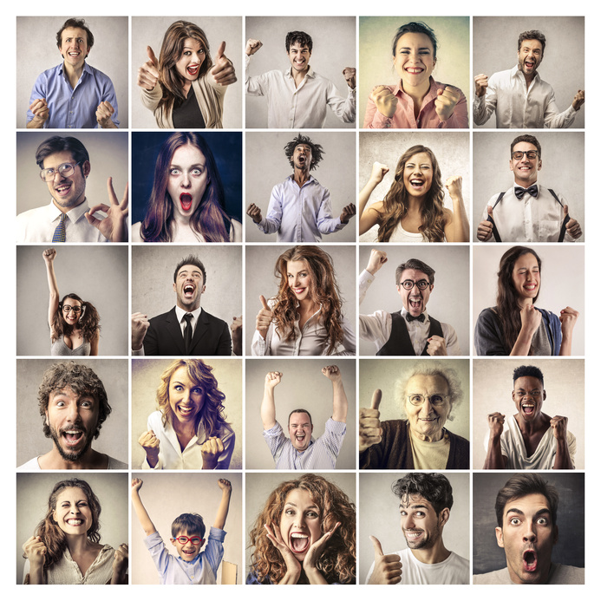
5 They embrace diversity
They reject conformity – they love different approaches and attitudes

Slide 3
6 They apply unexpected learning
They evolve beyond their original scope – they apply immediately whatever they learn out of the process!

Slide 4
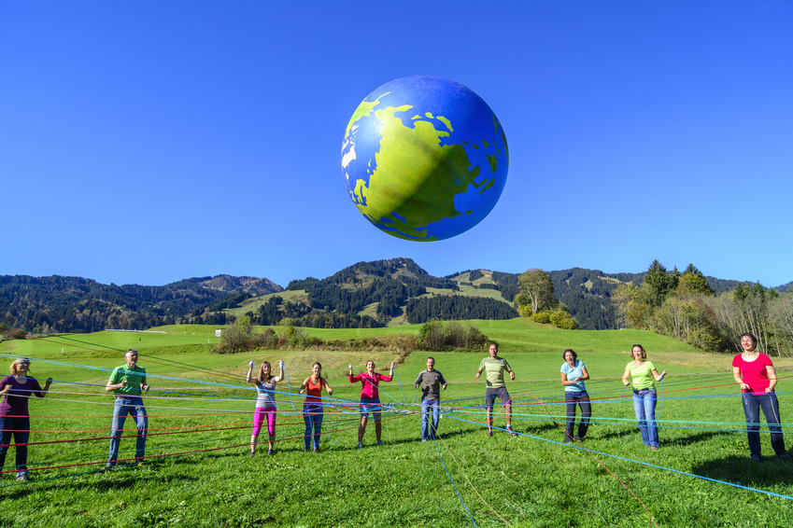
7 They strengthen team member relationships
They have common values and a shared vision!

Slide 5
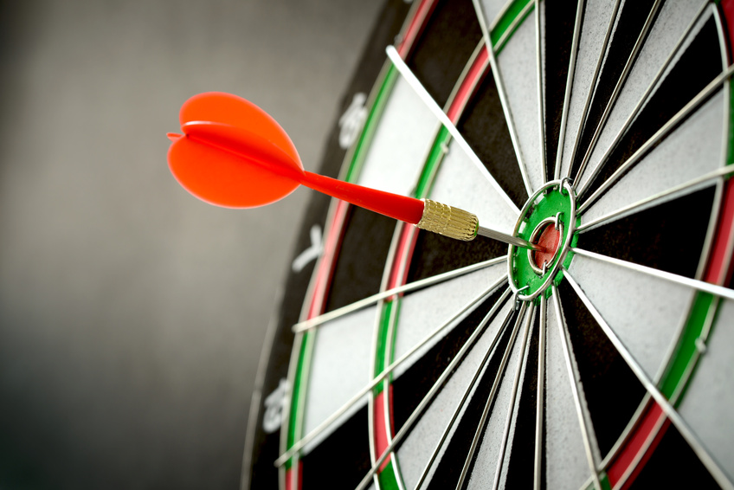
8 They have great results
Their measured results exceed expectations!

Slide 6
Great teams do not occur naturally or all of a sudden!
Great teams require team members who have technical, interpersonal, communicational and emotional intelligence skills.
Great teams require senior leadership efforts that create an environment where (A) teamwork is rewarded and (B) destructive team behaviour is corrected.
A kind of summary…

